Slide 1
Flowchart Recognition
from Hand-drawn Flowchart to Digital Components
SJSU CMPE 258
Mu Chen, MS-SE (mu.chen@sjsu.edu) [SJSU ID: 014725425]
Roger Kuo, MS-SE (roger.kuo@sjsu.edu) [SJSU ID: 013784706]
Hardy Leung, MS-AI (kwok-shing.leung@sjsu.edu) [SJSU ID: 016711877]
Jasmine Wang, MS-AI (jasmine.wang@sjsu.edu) [SJSU ID: 002805362]
Notes:
Good afternoon everyone. The title of our project is Flowchart Recognition, from Hand-Draw Flowchart to Digital Components. Our team include Mu Chen, Roger Kuo, Hardy Leung, and Jasmine Wang.

Slide 2
Why Flowcharts?
Incredibly versatile and flexible
Succinctly summarize or visualize concepts
PPT, Keynote, Google Docs all support FC
Very primitive
Hard to use
Mismatch between intents and outcomes
Disappointment
Deep Learning to the rescue
translate user’s intent to
accurate rendering of flow chart
Notes:
Flowcharts are incredibly versatile and flexible tools, often the most succinct way to summarize or visualize concepts such as workflow and relationships. Although software such as PowerPoint, Keynote, and Google Docs support flowcharts through drawing primitives, the creation process is often awkward and hard to control. Many people avoid flowcharts altogether, not to mention the inevitable discrepancy between what was intended and how it turns out. As such, the objective of our project is to apply deep-learning techniques to develop a hand-drawn flowchart recognition system that accurately translates user’s intent to actual rendering of flowcharts.

Slide 3
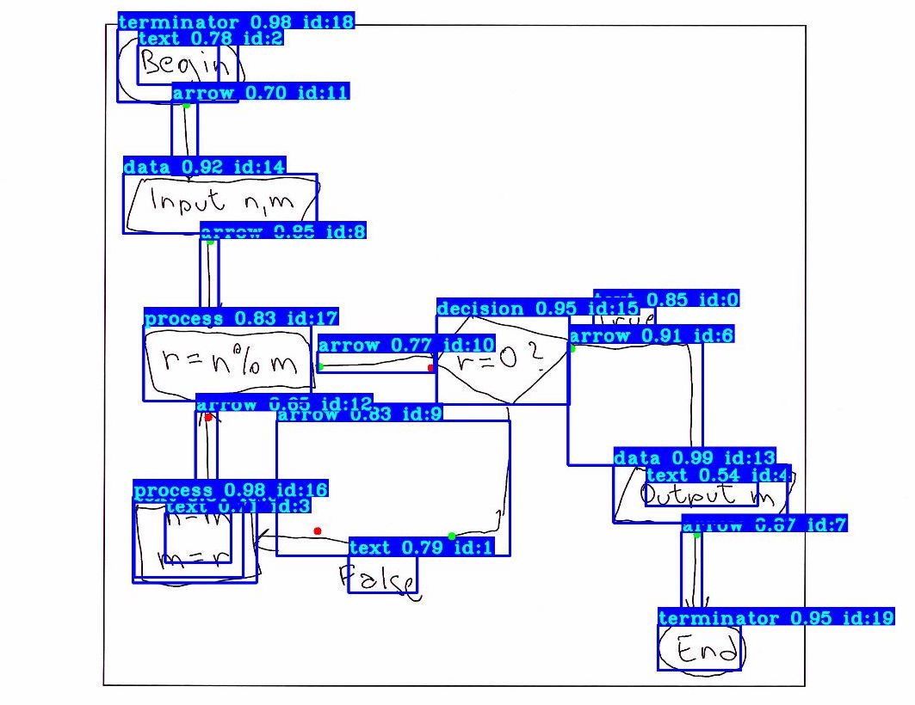
Architecture Overview
Custom-trained YOLO engine
Processing + Transformation + Analysis
Connectivity
Symbolic Relations
Text OCR
Result = Symbolic Flowchart
Intents fully captured
Can be rendered in several ways
Notes:
The key ingredient of our flowchart recognition system is the YOLO engine custom trained to detect flowchart objects. We then perform a series of transformations and analysis to extract connectivity and relationships. We also perform OCR to convert handwritings into actual English words. The result is a symbolic flowchart that fully captures the positional, relational, and textual intents of the user, which we can then render in several different ways. Roger will now cover more technical details.

Slide 4
Dataset and Preprocessing
600+ high-quality flowcharts
With xml annotations
80/20 training/testing split
Annotation conversion
From xml to YOLO format
Notes:
For our dataset, we used a collection of over 600 high-quality flowchart samples with annotations.
The annotation data includes bounding box coordinates and class IDs.
We split our data with an 80/20 ratio into training and testing sets.
For preprocessing, we converted the xml annotations into the accepted YOLO training format.
~ 30 seconds

Slide 5
Training
Custom YOLOv4 Model
Tiny YOLOv4 weights
Seven custom classes
Text; Arrow; Data; Decision, Process; Terminator; Connection
Achieved 90%+ mAP
96%+ accuracy on all flowchart elements except arrows and texts
Notes:
Using GPU acceleration, as well as the Tiny YOLOv4 weights for transfer learning,
we trained a custom YOLOv4 model that is able to detect seven different object classes that correspond to typical flowchart design.
This includes text, arrows, data, decisions, processes, terminators, and connections.
Our model was able to achieve a mean Average Precision of approximately 90%,
achieving averages above 96% for most of the classes.
~ 40 seconds
72% for arrows, 66% for text
6+ hours training

Slide 6
Detection
List objects with attributes
Position, Class, etc
Arrow head/tail detection
K-means clustering
Notes:
When passing a hand-drawn flowchart into our model,
the model detects and processes several pieces of information.
During detection, it compiles a list of objects,
detailing each object with a rich set of positional and logical attributes.
In addition, it uses k-means clustering to determine the head and tail positions of each identified arrow.
Next, Chen Mu will discuss rendering the digital output.
~ 30 seconds
Using the object list, it then calculates text-to-object relationships as well as arrow-to-objects relationships.
Finally, it uses the compiled arrow data to determine the correct flow of the original input diagram.
~ 45 seconds

Slide 7
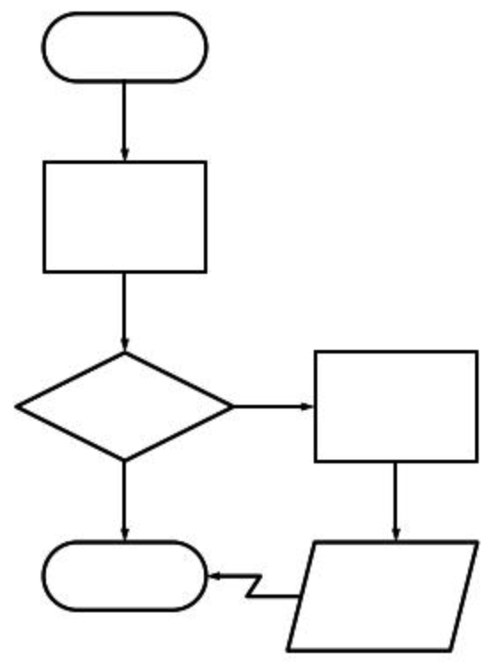
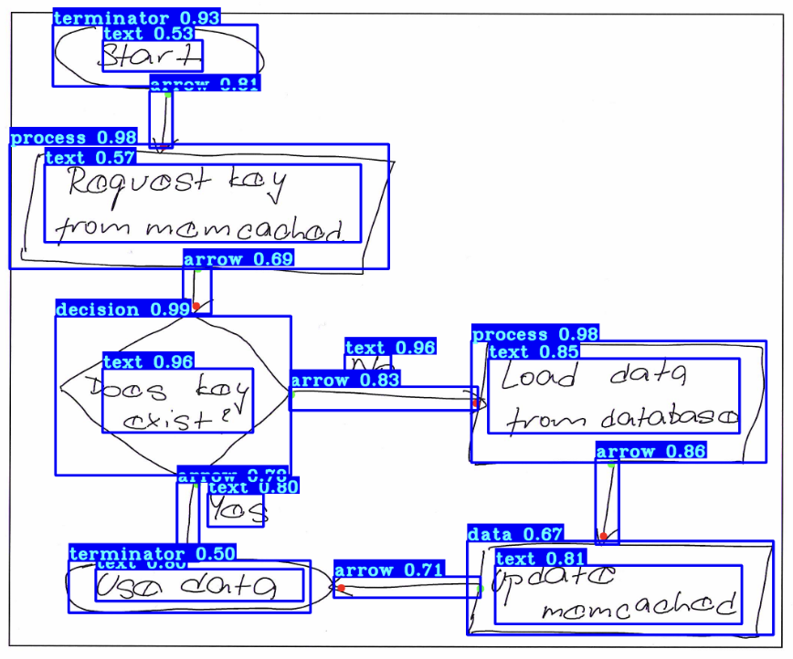
Flowchart Rendering
With all recognized objects
Extract arrow to shape relationships
Extract text to shape relationships
SchemDraw
Display flow chart based on shape relationships
Drawback: Rely heavily on the correctness of detection
Tesseract for text recognition (need improvement)
Text-Shape
{text_id: shape_id, …}
Arrow-Shape
{Arrow_id: (head_shape_id, tail_shape_id), …}

Slide 8
Discussion
Results:
Achieved 90%+ mAP with 96%+ accuracy on all flowchart elements except arrow and text
Challenges:
Arrow and text detection needs improvement
Current YOLO precision too low
Arrow head/tail detection needs improvement
Current method not resilient to noise
Schemdraw is not the most optimal rendering tool
Current method heavily relies on detection accuracy
Tesseract needs to be trained specifically for handwritten text
Future Plans:
Larger dataset to cover more variety and migrating to HPC to accelerate training
Overall code efficiency improvement including semi-automatic testing

Slide 9
References
Python scripts
https://pylessons.com/
Yolo v4
https://github.com/pythonlessons/TensorFlow-2.x-YOLOv3

